Slide 1


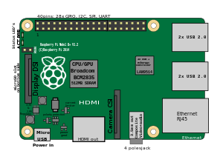

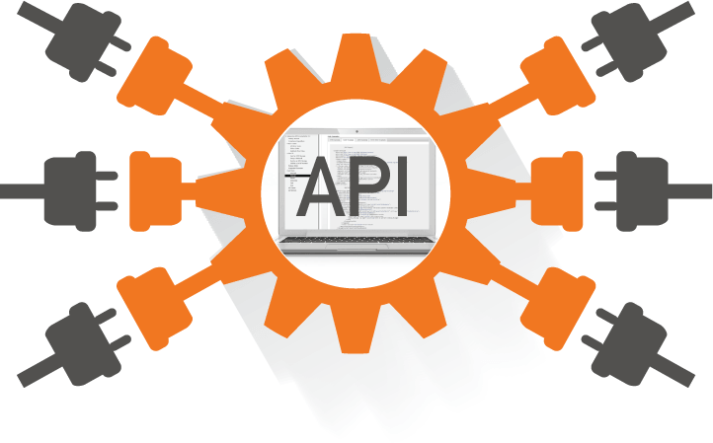
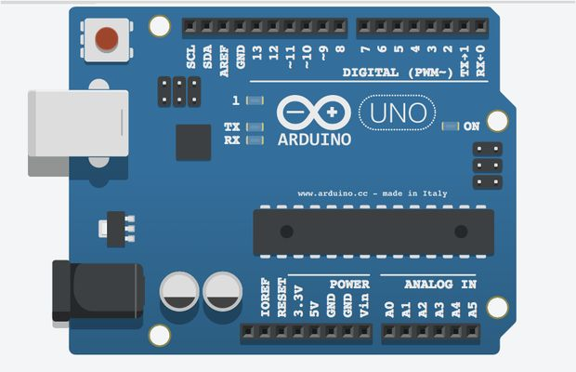

Persisting Data

Slide 2

Database
In order to store and retrieve information efficiently, we will store it in a database
Node.js can use many different databases
popular options: PostgreSQL, MySQL, Redis, SQLite, and MongoDB
dimensions to be considered: time-to-productivity, learning curve, performance, ease of replication, backup, cost, community support, etc.
There is no single "best" database
Two approaches for interacting with a database:
using the databases' native query language (e.g. SQL)
using an Object Relational Model (ORM)
represents the data as objects, which are then mapped to the underlying database
ORMs are slower
use translation code to map between objects and database format
may not use the most efficient queries
ORM allows programmers to think in terms of objects rather than db semantics
particularly true if you need to work with different databases
Unless you're very familiar with the native query language, you should use an ORM
There are many ORM solutions available on NPM
Mongoose, Waterline, Bookshelf, Objection, Sequelize, etc.

Slide 3
MongoDB
An alternative to relational databases
Problems with SQL
rigid schema
not easily scalable (designed for 90’s technology)
requires unintuitive joins
Benefit of using mongo
easy interface with common languages (Java, Javascript, PHP, etc.)
flexible schema
Cons
less flexibility with querying
Data Model
Database -> Database
Table -> Collection
Row -> Document
Column -> Field
Join -> Embedding, Linking, etc.

Slide 4
Collections, Documents, Fields
Why use new terminology?
collection vs. table, document vs. row and field vs. column
while these concepts are similar, they are not identical
Core difference:
relational databases define columns at the table level
document-oriented database defines its fields at the document level
Each document within a collection can have its own unique set of fields
a collection isn’t strict about what goes in it it’s schema-less
Install mongo and a shell to interact with it
MongoDB: https://docs.mongodb.com/manual/administration/install-community/
Robo 3T: https://robomongo.org/
Run: mongod --config /usr/local/etc/mongod.conf
Commands that you execute against a specific collection
db.help() or db.stats()
this is a JavaScript shell, if you execute a method and omit (), you’ll see the method body
db.getCollectionNames()
Since collections are schema-less, we don’t explicitly need to create them
simply insert a document into a new collection
db.sensors.insert( {name:'Temperature', unit:'celsius', value:22} )

Slide 5
Find, ID
You can use the find command to return a list of documents
db.sensors.find()
{ "_id" : ObjectId("5cacba924d45a140c16580fc"), "name" : "Temperature", "unit" : "celsius", "value" : 22.0 }
Notice: in addition to the data, there’s an _id field
every document must have a unique _id field
you can generate it or let Mongo generate one (ObjectId type)
By default, the _id field is indexed
db.sensors.getIndexes()
Insert a totally different document in the collection:
db.sensors.insert({name:'HeartRate', device:'Pulsimeter'})
again, use find to list the documents
what’s happen?

Slide 6
Query selectors
Like the “where” SQL clause for the find function
use it when finding, counting, updating and removing documents from collections
a JSON object which matches all documents
Add some test data
use data.js
Where:
{field: value} finds any documents where field is equal to value
{field1: value1, field2: value2} an AND statement
$lt, $lte, $gt, $gte $ne are used for less than, etc... operations
example: get all type “m” devices that weight more than 700:
db.devices.find({type: 'm', weight: {$gt: 700}})
db.devices.find({type: {$ne: 'f'}, weight: {$gte: 700}})
$exists is used for matching the presence (absence) of a field
db.devices.find({values: {$exists: false}})
$in is used for matching one of several values, like an OR statement
db.devices.find({tags: {$in:['tag_a','tag_c']}})
$or is used to have OR rather than AND for conditions on different fields
db.devices.find({type:'f', $or:[{tags:'tag_c'},{weight:{$lt:600}}]})

Slide 7
Query selectors
Notice that “tags” field is an array
MongoDB supports arrays as first-class objects
this is an incredibly handy feature
once you start using it, you wonder how you ever lived without it!
It is easy selecting based on an array value
{tags: 'tag_a'} will return any document where ‘tag_a’ is a value of “tags”.
There are more available operators
described in the MongoDB manual
Selectors can be used also with the remove, count and update commands
ObjectId can be selected like this:
db.device.find({_id: ObjectId('TheObjectId')})

Slide 8
Updating
Simplest form takes two parameters
the selector (where) and what updates to apply to fields
db.devices.update({name: 'Device 1'}, {weight: 620, pippo: 56})
Ooops, what happens?
update found a document (by selector) and replaced it with the new document (the second parameter)
To change the value of just one ( or few) field, use $set operator
db.devices.update({name: 'Device 2'}, {$set: {weight: 590}})
Other operators
$inc is used to increment a field by a certain positive or negative amount
db.devices.update({name: 'Device 3'}, {$inc: {values: -2}})
Fully supports upserts
updates the document if found or inserts it if not
to enable upserting, pass a third parameter to update {upsert: true}
db.devices.update({name:'Device 15'}, {$set: {hits:1}},{upsert:true})
Multiple updates
by default, update updates only the first matching document
pass the parameter {multi: true}
db.devices.update({}, {$set: {verified: true }}, {multi:true});

Slide 9
Projection, Cursor, Ordering and Paging
Projection is an optional parameter of find() to list the fields we want to retrieve/ exclude
db.devices.find({}, {name: 1})
by default, the _id is always returned, but we can explicitly exclude it
db.devices.find({}, {name: 1, _id: 0})
aside from the _id, you cannot mix inclusion and exclusion
Find returns a cursor whose execution is delayed until needed
from the shell find appears to be executes immediately (a behaviour of the shell only)
observe the true behaviour by chaining methods to find
Sort: we can specify the fields we want to sort on as a JSON document
use 1 for ascending and -1 for descending
db.devices.find().sort({weight:-1})
db.devices.find().sort({name: 1, values: -1})
Paging can be accomplished via limit and skip cursor methods
to get the second and third heaviest devices:
db.devices.find().sort({weight: -1}).limit(2).skip(1)
it is always better to get list of entities in a paginated way

Slide 10
Arrays and Embedded Documents
Arrays can be used for many-to-one or many-to-many relationships
example: a measurement realized by two devices:
db.measurements.insert({_id:ObjectId('4d85c7039ab0fd70a117d733'), value:76, devices:[ObjectId('6272386cdf012d4f4ba31b3b'), ObjectId(’6272386cdf012d4f4ba31b3c')]})
Notice that for some documents, the same field can be a scalar value, while for others it can be an array!
Arrays of values are much more convenient to deal with than many-to-many join-tables
Mongo supports also embedded documents
db.measurements.insert({value:96, user:{name:'Pio',surname:'Blu’}})
Embedded documents can be queried using a dot-notation
db.measurements.find({'user.name':'Pio’})
Combining the two concepts, we can embed arrays of documents

Slide 11
Indexes
Indexes in mongo work like indexes in a relational database
help improve query and sorting performance
without indexes, mongo must perform a collection scan to select documents
special data structures (Btree) store value of a specific field (or set of fields) ordered by the value of the field
Created using ensureIndex and dropped using dropIndex
db.devices.ensureIndex({name: 1})
db.devices.dropIndex({name: 1})
The index can be set as unique
do not store duplicate values
db.devices.ensureIndex({name: 1}, {unique: true})
We can also create compound indexes
indexes on multiple fields
db.devices.ensureIndex({name: 1, values: -1});
Indexes on embedded fields (dot-notation) and on array fields
if you index a field that holds an array, mongo creates separate index entries for every element of the array
More: Geospatial Index, Text Indexes, Hashed Indexes

Slide 12
How to model data?
Embedded documents or referencing?
a document size is currently limited to 16 MBytes
embedded mostly used for “smaller” pieces of data (always pull with the parent)
example: store an addresses with each user
don’t underestimate the power of embedded documents
often removes the need to join
Few or many collections?
no enforced schema, so it’s possible to build a system using a single collection
very bad idea
better to model similarly a relational system (with fewer collections)
if it would be a table in a relational db, there’s a chance it’ll be a collection in mongo
many-to-many or one-to-many join table are exceptions
Example from a blog
should you have a “posts” collection and a “comments” collection, or should each post have an array of comments embedded within it?
most developers should prefer to separate things out: cleaner
you can combine, keep comments in their own collection, but embed few comments in the post to be able to display them with the post
Principle: keep together data that you want to get back in one query

Slide 13
Aggregation
Process data records and return computed results
groups values from multiple documents together
perform a variety of operations on the grouped data
return a single result
MongoDB provides three ways to perform aggregation
Aggregation Pipeline
array of data transformations applied to the data in order
db.devices.aggregate([ ... aggregation steps go here ...]);
the first stage is matching
to filter out documents
then grouping together the ones into useful subsets, or to perform operations across a common field in all documents
e.g. calculating the sum of some field
db.devices.aggregate([{$match: {weight: {$gt: 700}}}, {$group: {_id: null, total: {$sum: '$values'}}}])
Single Purpose Aggregation Methods
simple access to common aggregation processes
lack the flexibility of the aggregation pipeline
db.collection.estimatedDocumentCount()
db.collection.distinct()
Map-Reduce function...

Slide 14
When to use Mongo?
Mongo should be seen as a direct alternative to relational databases
schema-less
more flexible than traditional database tables
schema-less is cool, but most of your data is going to be highly structured
occasional mismatch can be handy (e.g. introduction of new features)
lack of setup and reduced friction with OOP
you want to save an object? serialize it to JSON and send it to mongo
no property mapping or type mapping
Example: a logging db
Control over write performance and data durability
possibility to send write commands that return immediately (without waiting)
control the write behaviour with respect to data durability
capped collection
db.createCollection('logs', {capped: true, size: 1048576})
when collection reaches its limit, old documents are automatically purged
possibility to specifying how many servers should get data before considered successful
replication…
Full text search, Geospatial
stemming and stop words, geoJSON

Slide 15
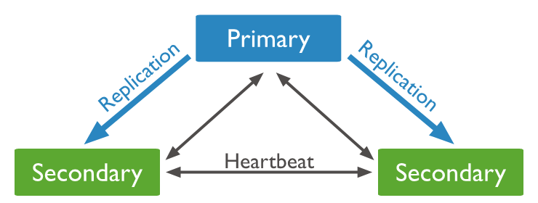
Replication and Sharding
Replica set
three or more servers that hold the same data
writes are sent to a single server (the primary) then it’s asynchronously replicated to every secondary
performance and high availability
long queries can be moved to secondaries to reduce load on the primary
the risk of reading slightly stale data
if the primary goes down, a secondary will be elected as the new primary
Sharding
approach to scalability which partitions data across multiple servers
simple implementation: data of users with names A-M on server1 and the rest on
CAP theorem: any distributed datastore can provide only two of the following three guarantees
consistency: every read receives the most recent write or an error
availability: every request receives a response (not guarantee to the most recent write)
partition tolerance: the system continues to operate despite an arbitrary number of messages being dropped (or delayed) by the network between nodes
thus, if there is a partition, you must choose between consistency or availability

Slide 16
Transaction
Tasks executed in ACID way
Atomicity
a transaction is treated as a single "unit", which either succeeds completely, or fails completely
Consistency
transactions can only bring the db from one valid state to another
Isolation
concurrent execution of transactions leaves the database in the same state that would have been obtained if the transactions were executed sequentially
Durability
once a transaction has been committed, it will remain committed even in the case of a system failure
An operation on a single document is atomic
embedded documents and arrays captures relationships between data in a single document and obviates the need for transactions (multi-docs) for many practical cases
Multi-document transactions
used across multiple operations, collections, databases, and documents
it’s ACID, but needs a replica set
Advanced topic…
https://thecodebarbarian.com/a-node-js-perspective-on-mongodb-4-transactions.html

Slide 17
Stats, Backup, Restore, Profiler
To obtain statistics on a database/collection
db.stats()
db.devices.stats()
information deals with the size and indexes
The profiler tells us what was run and when, how many documents were scanned, and how much data was returned
db.setProfilingLevel(X)
0 profiler is off and does not collect any data
1 profiler collects data for operations that take longer than 100 ms
2 profiler collects data for all operations
db.system.profile.find()
mongodump backups all of databases to a dump subfolder
options to select a db, a specific collection
mongorestore is used to restore a previously made backup
mongoexport to use different data formats than BSON (JSON and CSV)
mongoexport --db mydb --collection devices --csv --fields name, weight

Slide 18
Mongoose
An Object Data Modelling (ODM)
provides a modelling environment for data
enforces structure
still maintains the flexibility of MongoDB
Install mogoose
npm install mongoose
Code: WoT Fog Server
Connection to Mongo
see database.js
const mongoose = require('mongoose'); mongoose.connect(mongodb://localhost:27017/wotserver-prod); mongoose.connection.on('error', (err) => { console.error('Database connection error '+ err.message);});
it is best to open db connection once (at startup) and leave it open until app shuts down

Slide 19
WoT Fog Server
Database (MongoDB)
Next
PERSISTENCE
(Mongoose)
Middleware x
BodyParser
Routers
Observe
GETs / PUTs
Client
MODEL
SERVER
(Express)
Client
WebSocket
Plugin 2
Plugin 3
Plugin 1
Plugin m
Client
Resources, Verbs, Representations
Middleware k
Observe
Middleware y
Converter
Driver
Next
Devices

Slide 20
Mongoose Schema
Schemas
defines the shape of a document
see /models/measurementSchema.js
const measurementSchema = new mongoose.Schema({ type: { type: String, required: true }, value: { type: Number }, timestamp: { type: Date, default: Date.now } });
Each key defines a property in our documents
it will be cast to its associated SchemaType
the property “type” will be cast to the String SchemaType
property “timestamp” will be cast to a Date SchemaType
The permitted SchemaTypes are
String, Number, Date, Buffer, Boolean, Mixed, ObjectId, Array, Decimal128, Map
Exporting a Model
we need to call the model constructor and pass it the name of the collection and a reference to the schema definition
module.exports = mongoose.model('Measurement', measurementSchema);

Slide 21
Persist and fetch values
We can create an instance of the model and populate it
see /plugins/tempPlugin.js and /plugins/lightPlugin.js
const Measurement = mongoose.model('Measurement');
(new Measurement({ type:MeasurementTypes.temperature, value: model.value })).save();
We can retrieve values we saved to the database earlier
we can add a new route in order to expose measurements data
see /routes/measurements.js
const filter = JSON.parse(req.query.filter); const options = { select: JSON.parse(req.query.select), sort: JSON.parse(req.query.sort), page: parseInt(req.query.page), limit: parseInt(req.query.limit) } const measurements = await Measurement.paginate(filter, options);
GET /iot/measurements?filter={"type":"temperature [Celsius degree]"}&limit=2&page=6

Slide 22
More...
Updates and delete values
findOneAndUpdate method
findOneAndRemove method
References
to other schemas
Virtual properties
not persisted to the database, but added to the schema as a helper to get and set values
Plugins
E.g. “mongoose-paginate”

Slide 23
Hands-on Activity
Create a collection of users
Insert different users (documents) inside, with fields like: name, surname, phone, address, gender, bird date
Get familiar with different selectors: use find to select different sets of users (e.g. female, less than 40 years old, etc.)
Try to use count and remove
Create a new schema for “logs”
Add a new log document every time the API get a request
Create a new route in order to expose logs

